Slide 1
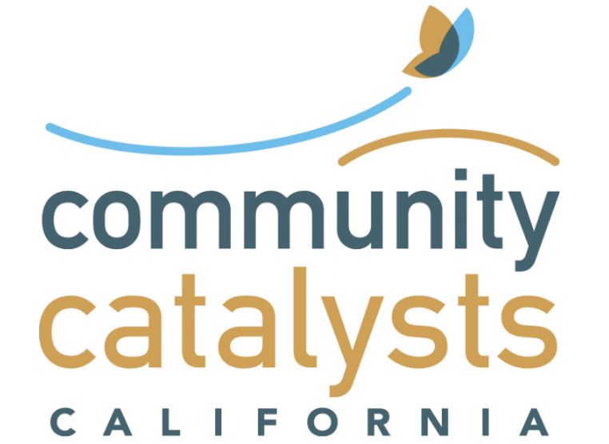
Community Information Exchange Partners: 76
Data Sharing Partners

